Slide 1


Audio & the Web
Pitchy & Scratchy
What about the sounds ?

Slide 2

As everything evolves...

Slide 3
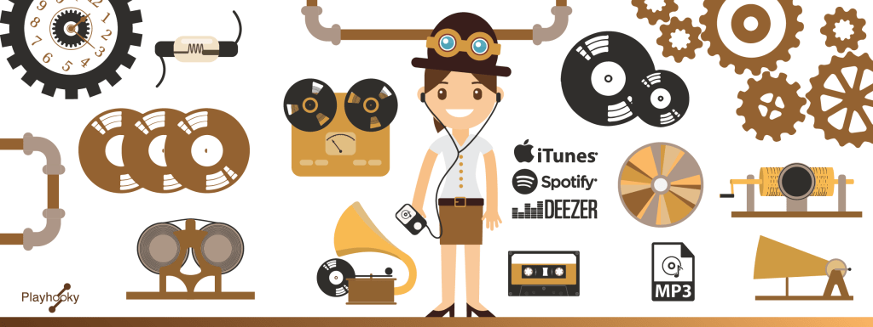
Evolution of sound recording

Slide 4

Evolution of computers

Slide 5

Evolution of storage mediums

Slide 6

Evolution of telephony

Slide 7
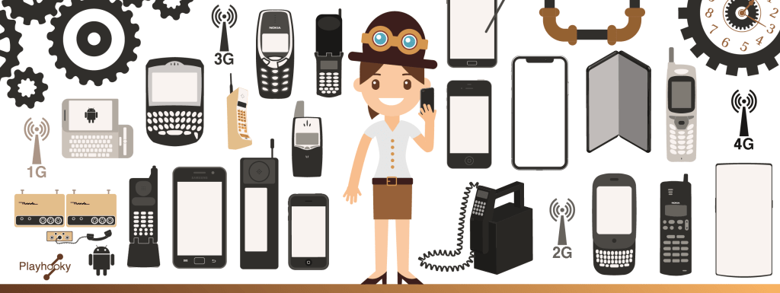
Evolution of mobile phones

Slide 8
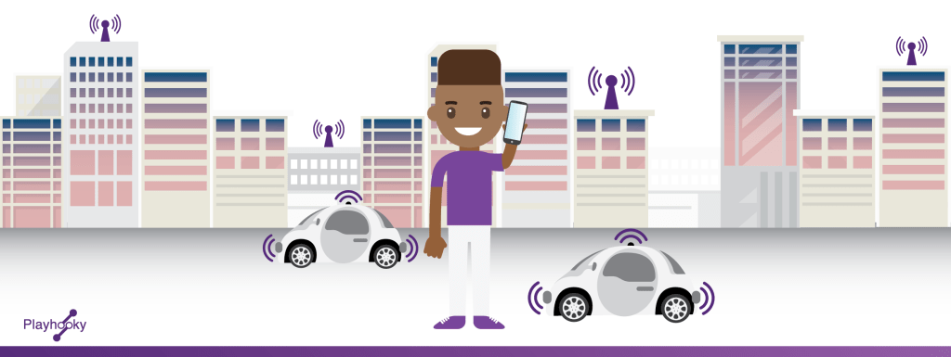
Evolution of telecoms

Slide 9

Evolution of wireless technologies

Slide 10
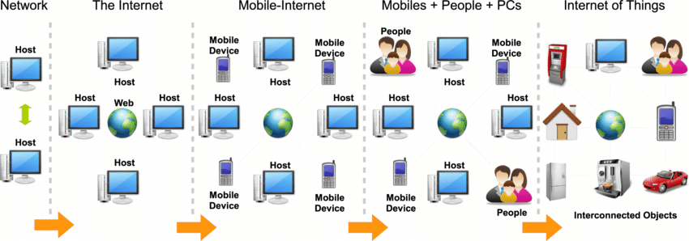
Evolution of the Internet

Slide 11
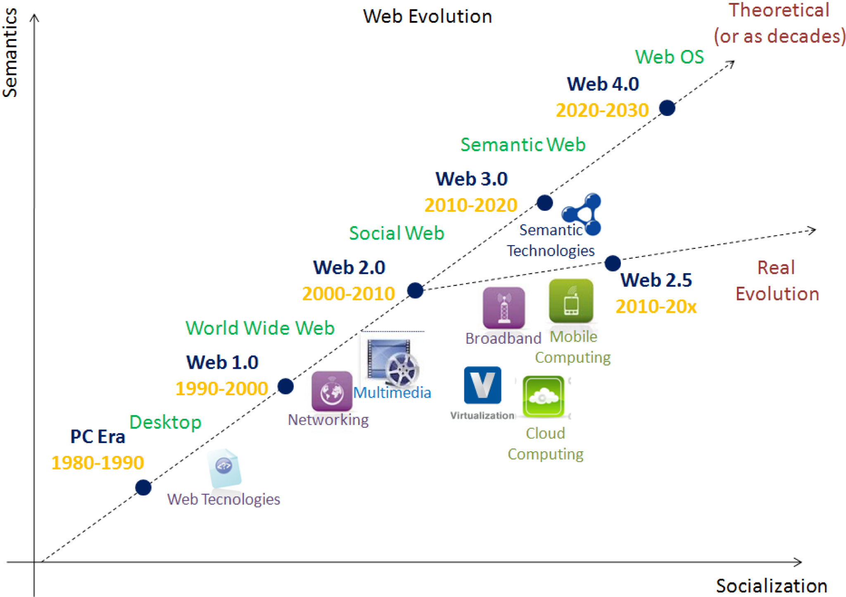
Evolution of the Web
...and...

Slide 12
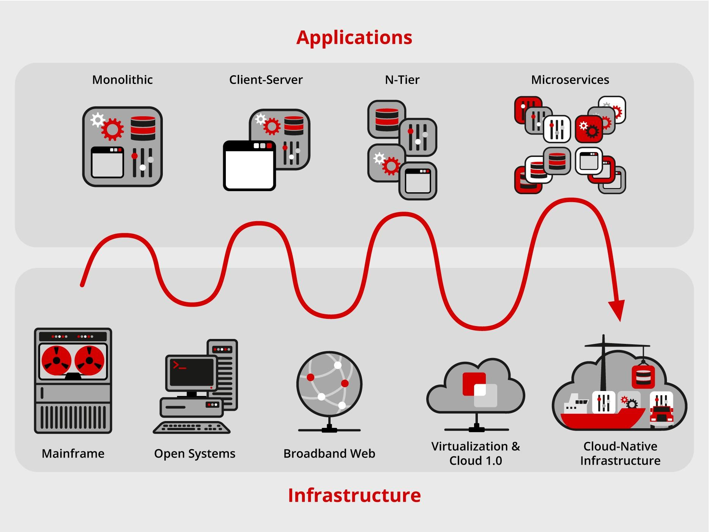
Evolution of apps
+
infras

Slide 13
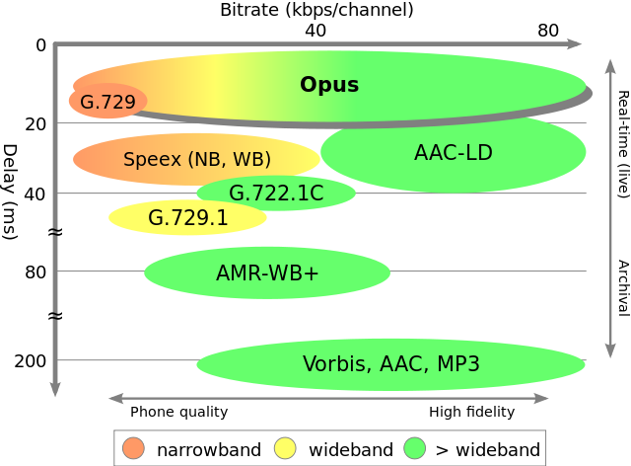
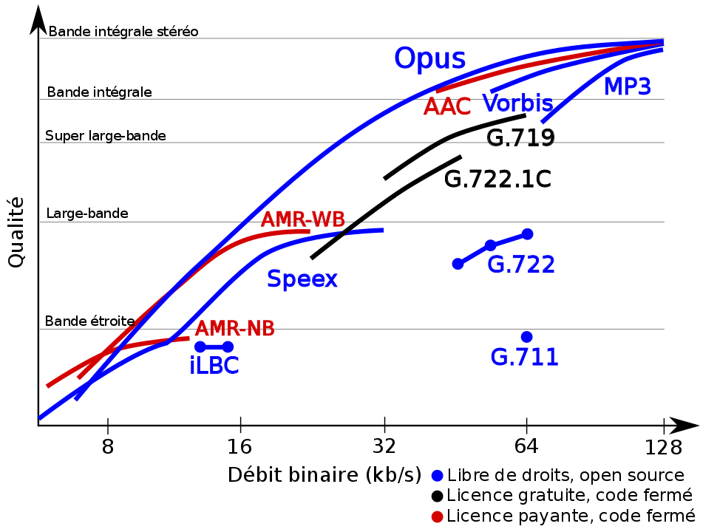
Evolution of codecs and files formats definitions

Slide 14

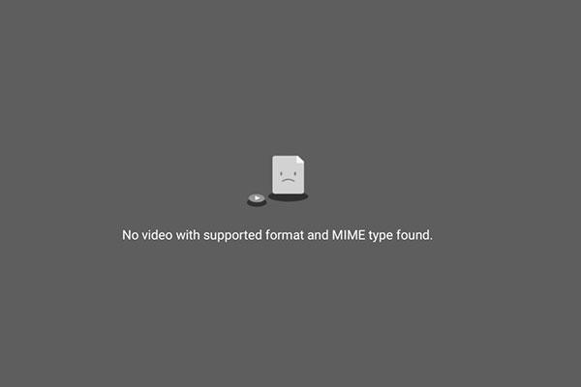
Audio issues
(not from hardware, volume, deafness and connection…)
Invalid link, missing file...
Wrong code,
lack of updating, ...
Browser issues,
incompatibilities,
file not supported...
No API, no controls...
Language syntax, semantics, accessibility, user preferences...

Slide 15

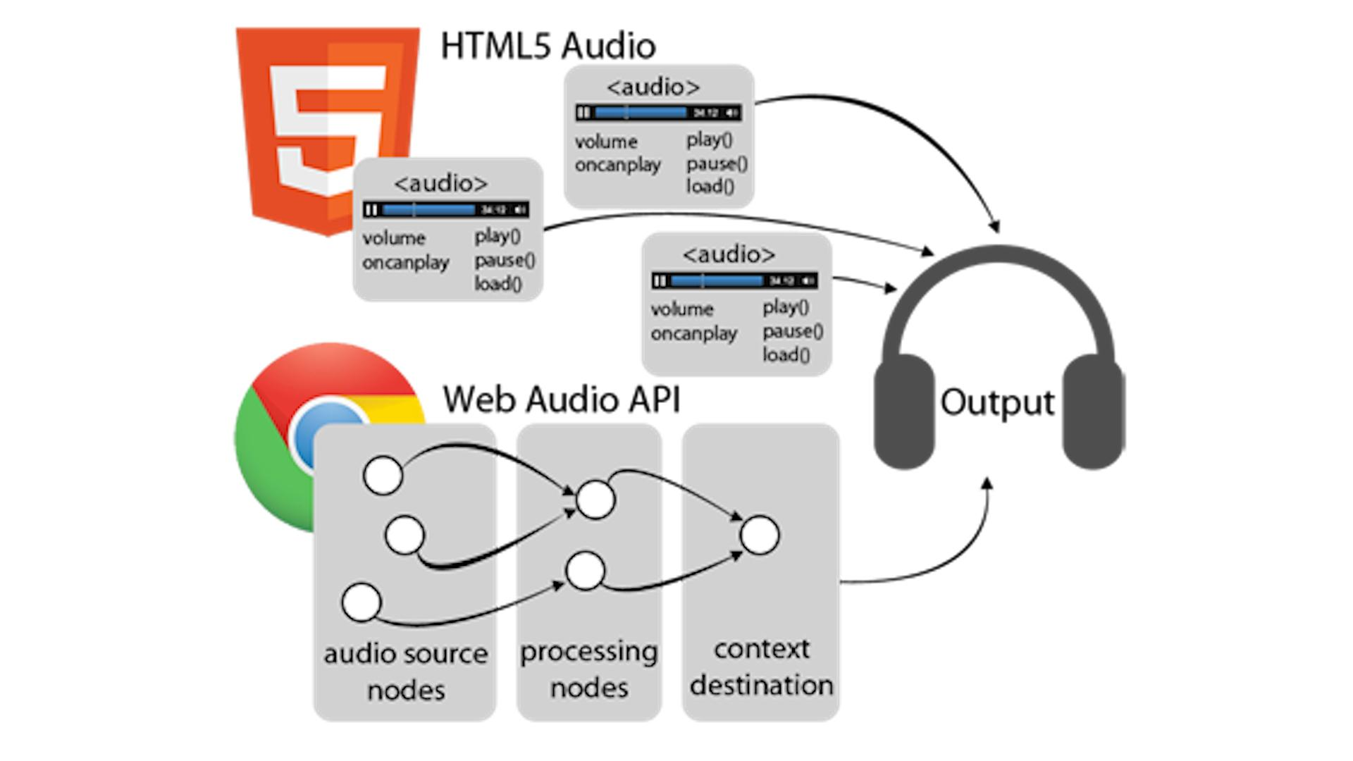
Useful tools

Slide 16


Thank you !
https://github.com/VincentG2021/Audio-and-the-Web

